Slide 1

Creating End to End Policy with Flexible Policy Engine
YOTA
Sergey Malygin
Director, Program Management & Solution Delivery

Slide 2

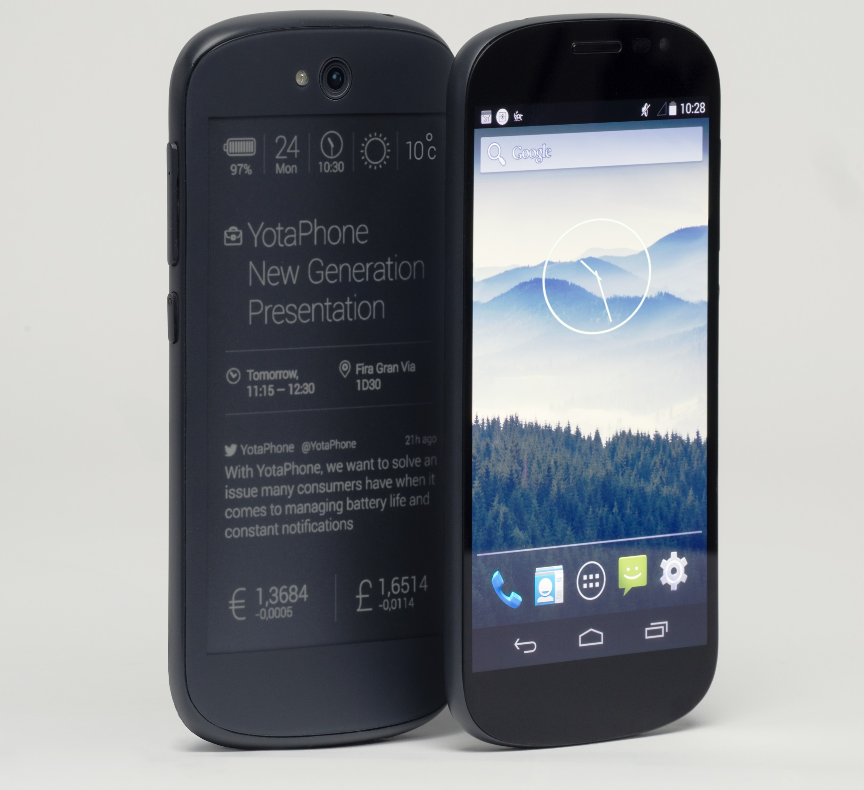
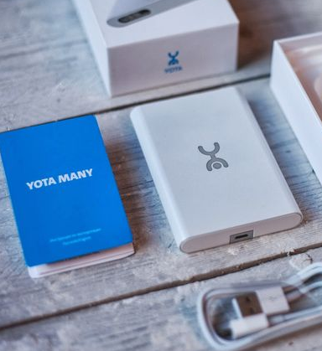

What is Yota?
Yota Mobile Internet
Yota Phone
Yota PCRF

Slide 3
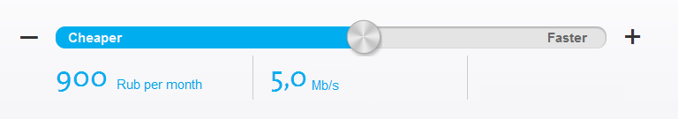
Yota Mobile Operator
WiMAX
Mobile Broadband
2g / 3G / LTE Data
+ Voice
LTE
Mobile Broadband
> 1 million subscribers
2008
2012
2014
Unlimited data tariffs
AS IT SHOULD BE

Slide 4

Key Drivers & Challenges
Yota is REALLY dynamic company:
    New offers, New DPI, WiMAX -> LTE swap, etc.
Time to Market is CRITICAL!

Slide 5
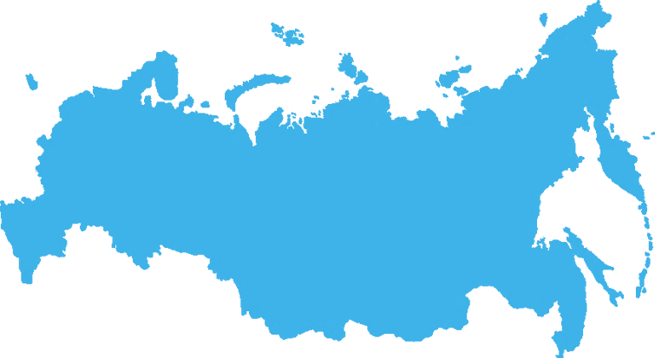

Challenges - ACCEPTED
7 cores / RAN Sharing / Multi PCEF: Huawei, Cisco, Procera,
Unified PCC Solution
Advanced Service Model
User features:
      Sliders
      Turbo Button
      Test Drive
      Offers based on device type
> 30 regional tariffs
> 10 000 km
9 time zones
Russia-wide
Operator features:
      Advanced Policy Control
      Congestion Management
      Online User Interaction
      PCC Notifications to BSS

Slide 6
YOTA PCC Architecture
Notes:
Поменять шрифт (увеличить)

Slide 7
Flexible Policy Engine
Network session:
Network Events
Usage monitoring
Location/ cell ID
Device type (IMEI)
BS Load info
Real-time cell load
Core Network
Policy
Engine
Subscriber
Rating
Schedule & Timers
Date & Time
Day of week
Time accumulation
BI
Subscriber info:
  Profile
  Services
  Attributes
  Counters
ANY
External
Events
BSS
Provisioning

Slide 8
Script-based Policy Configuration
if service_active("Bronze") then
if not country == 'RU' then -- default country for PCRF installation
log_write(string.format("Subscriber now in %s country", country))
add_rule_static("Roaming")
add_policy("Limited")
return 0
end
if check_accum_level_full("General_Down") then -- no traffic add_policy("Limited")
add_rule_static("Redirect_to_page")
log_write("Subscriber redirected to selfcare page")
return 0
end
if service_active("Turbo") then -- turbo button pressed add_policy("Turbo")
log_write("Turbo button active - add Turbo policy")
else
add_rule_static("Bronze")
log_write(string.format("Add static Gx rule %s", "Bronze"))
end
return 0
Lua
Online or scheduled update
Script debug
Script versions
Fast rollback
Can be applied for dedicated subs or %
HAL (Hardware Abstraction Layer)
Notes:
Add animation

Slide 9
Time 2 Market Benefits
Update subscriber contact information reminder – 3 times OK / CANCEL,
4-th time – CANCEL is not possible
Controlled customer care load – show new offer only for 20% of subs
Notify external system about subscriber authorization in the network
Subscriber home area leave notification to BSS
API for Mobile App: “Should I show the Turbo-button for this subscriber?”
In case of DPI failure perform online fallback for policies enforcement to
P-GW
Idea EVALUATION
1 week - 1 month
Idea IMPLEMENTATION (configure, test and launch)
1 day - 1 week
Notes:
Add animation + color

Slide 10
Yota PCRF Benefits
Multi-PCEF
Performance
15’000 TPS
per 1 node (HP DL360)
Congestion Mgmt
Advanced Service Model
TimesTen
or
Postgres
Availability
99.999%
Flexibility
Lua Generic Attributes

Slide 11

Good for education, evaluation and testing
One-click download for soft & docs
No registration / NDA / SMS, etc.
SMalygin@yotateam.com
www.freepcrf.com

